Slide 1
Model Predictions of Loan Application Data
Team Members:
Faisal
Jessica
Jonathan
Mary

Slide 2
INTRODUCTION
Models were trained using data from a clean loan application CSV data file (45000 data elements).
The models were trained to predict low-risk and high-risk loan applicants.

Slide 3
Models: Neural Network
Logistic regression
Random Forest Classifier
Keras Sequential

Slide 4
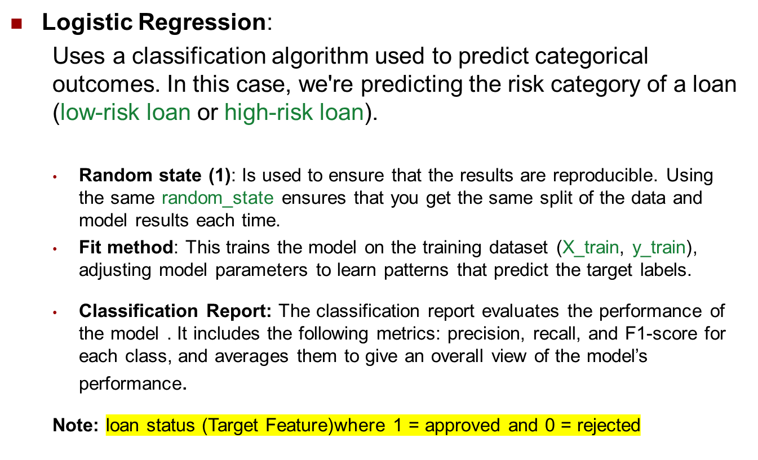
Logistic Regression Model

Slide 5
Classification Report
precision recall f1-score support
low-risk loan 0.85 0.96 0.90 8749
high-risk loan 0.76 0.42 0.54 2500
accuracy 0.84 11249
macro avg 0.81 0.69 0.72 11249
weighted avg 0.83 0.84 0.82 11249
Key Observations:
Low-risk loans are predicted very well, with high precision (85%) and recall (96%), which is great.
High-risk loans have lower performance, especially recall (42%). This suggests that the model is struggling to correctly identify high-risk loans.
Overall, the model has good accuracy (84%), but there is room for improvement in detecting high-risk loans and achieving our (85%) goal

Slide 6
Random Forest Classifier
To improve the class imbalance identified in the Logistics Regression model, an alternate model was used, Random Forest, which might handle imbalanced datasets better.
  class_weight='balanced': This adjusted the weights of the classes inversely proportional to their frequency in the data, helping to address class imbalance by giving more importance to the minority class (in this case, high-risk loan).

Slide 7
Classification Report
precision recall f1-score support
low-risk loan 0.93 0.98 0.95 8749
high-risk loan 0.90 0.76 0.82 2500
accuracy 0.93 11249
macro avg 0.92 0.87 0.89 11249
weighted avg 0.93 0.93 0.93 11249
Key Observations:
Low-risk loans are predicted excellently with a high precision (93%) and recall (98%), showing that the model is doing a great job at identifying low-risk loans.
High-risk loans have good performance as well, though the recall at (76%) which is an improvement from the (42%) from the Logistic Regression model. This means there are still some high-risk loans that the model is missing, but it does a good job at predicting them overall.
Accuracy has increased to 93%, which is a strong improvement compared to the previous model (84%).

Slide 8
Keras Sequential Model
Model Summary:
  The deep neural network consists of three layers:
    Input layer
    Two hidden layers with 20 and 64 neurons respectively
    Output layer with 1 neuron
  The model achieved an accuracy of (92.3%) on the training data along with a loss of (.1759%). Which is an indication the model is performing well in terms of both classification accuracy and binary cross-entropy.
  Key Observation:
  The Keras Sequential model performed better that the Logistic Regression model. This maybe due to the complexity of the data. Neural networks captures complex, non-linear relationships whereas Logistic Regression may struggle

Slide 9
Model Prediction Conclusion
  The Keras Sequential model proved to be more efficient than the Logistics Regression model. Although, Random Forest proved to be just as efficient, it was used to overcome the short-comings of the Logistics Regression model, which is used in industry.
  An analyst should consider the complexity of the received data and choose, based on knowledge and experience, the most efficient model available. This would drive-down cost and schedule.

